Slide 1
Extended Essay Introduction

Slide 2
The aims of the Extended Essay are:
Pursue independent research on a focused topic
Develop research and communication skills
Develop skills of creative and critical thinking
Engage in a systematic process of research appropriate to the subject
Experience the excitement of intellectual discovery

Slide 3
As a student you are expected to:
Plan and pursue a research project
Formulate a precise research question
Gather and interpret material
Structure a reasoned argument in response to research question on basis material gathered
Present in appropriate format, acknowledging sources
Use language appropriate to the subject with skill and understanding
Apply analytical and evaluative skills understanding implications and context research.

Slide 4
General advice:
Read the assessment criteria - link below and in the EE guide
Read previous essays - sample marked essays
Spend time working out the research question - a focussed RQ is the key to a good EE
Work out a structure for the essay that relates to the research question
Record sources as you go along
Use appropriate language for subject
Let interest and enthusiasm show.
Rewrite intro at the end

Slide 5
Avoid:
Researching question that is too broad or too vague
Choosing topic where cannot find evidence to answer the research question.
Ignoring the assessment criteria
Using Internet uncritically
Plagiarising
Merely describing - evidence must be used to support the argument
Citing sources not used
Choosing to write EE in subject not studied

Slide 6
What are the different parts of the Extended Essay? What does it look like?
Title page - including word count
Contents page - pages must be numbered
Introduction
Body of the essay (development/methods/results) – use sub-headings
Conclusion incl limitations, questions not resolved
References and Bibliography - list only sources used in essay
Appendices - examiner is not bound to read
Reflections on Planning and Progress Form - records reflections on your planning and progress, and the nature of your discussions with your supervisor

Slide 7
Limit is 4,000 words - this does not include:
contents
maps, charts, diagrams, illustrations, tables
equations, formulas and calculations
references, footnotes
bibliography & appendices.
RPPF

Slide 8
Role of the Supervisor
You will have a supervisor (teacher) who will help guide you through the process:
discuss your work with you
give you some advice
only give written feedback to once
3–5 hours to include three formal reflection sessions, as well as supervision sessions called check-in sessions.
Check in sessions - informal meetings to discuss progress/answer questions
Formal reflection sessions - mandatory sessions, after which the RFFP is completed

Slide 9
Approaching the EE - where to start?
One of the most difficult things is to get started.
Follow the 12 points on this Initial Guidance on research and writing
Complete the Extended Essay Proposal form
Develop a clear and focused question centred on a research topic. 5 steps of developing a research question.

Slide 10
Academic Honesty
The IB and IST take academic honesty very seriously.
Academic honesty

Slide 11
Researchers Reflection Space
Student reflection in the extended essay is critical. Effective reflection highlights the engagement of the student in an intellectual and personal process and how this has changed the student as a learner and affected the completion of that individual’s essay.
Use the Researcher's Reflection Space on ManageBac

Slide 12
RPPF
You are required to complete the RPPF form during the process and when you have met with your supervisor. You must share you thoughts, questions, discoveries, challenges, etc. There are three formal meetings, after which the written reflection is recorded on ManageBac
First Formal Reflection Meeting - after topic area has been selected and a supervisor agreed (a few check in sessions may have happened)
Interim Reflection Meeting - before the summer holidays, before the first draft
Final Reflection Meeting (Viva voce) - after the final version has been submitted
Examples of students reflections and the mark given for Criterion E

Slide 13
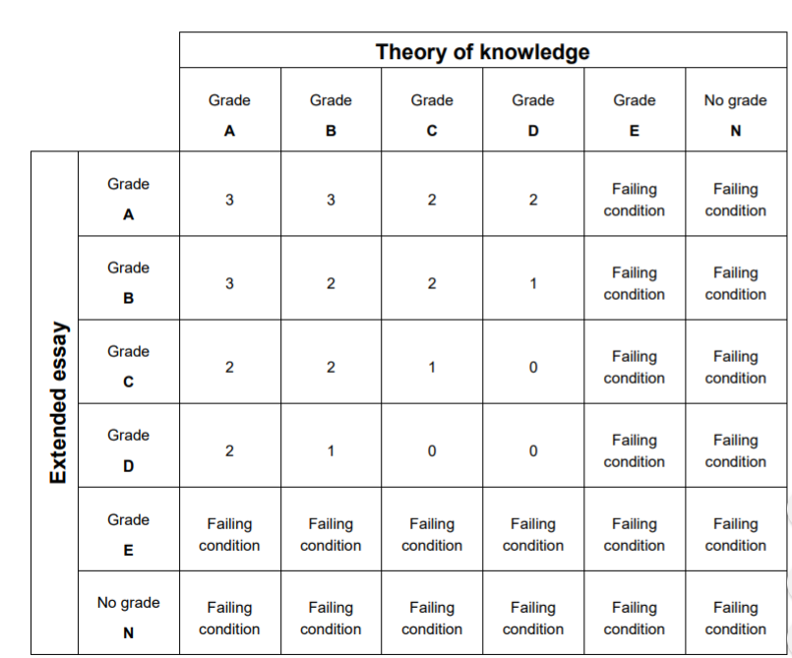

Slide 14
Stage | Date
Initial presentation | February 2023
Application for subject – to IBDP Coordinator (two alternatives must be given and reasons for choices) | 8 March 2023
Allocation of subject – IBDP Coordinator | March
Complete EE Proposal on ManageBac Supervisor check in session 1 – title/theme established | 24 March 2023
Supervisor check in session 2 – research question / hypothesis stated | March
First Formal Reflection Meeting Complete first reflection on ManageBac - planning & progress tab | 14 April 2023
Sources surveyed Experiment/survey/analysis planned Collection of primary data | April/May
Supervisor check in session 3 – check progress | May
Extended Essay Day Complete surveying sources and collection of data Start writing | 13 June 2023
Interim Reflection Meeting Complete interim reflection on ManageBac - planning & progress tab | 23 June 2023
Write first draft | Summer holidays
Supervisor check in session 4 – check progress | First week of term
Submit first draft Written feedback provided | 6 September 2023 October
Final EE handed in - upload to ManageBac | 8 November 2023
Final Reflection Meeting - Viva Voce Complete final reflection on ManageBac - planning & progress tab | 24 November 2023 1 December 2023

Slide 15
What now?
Discuss ideas with friends, parents etc.
Teachers will speak to you/ask your teachers about doing an EE in the subject – HL
Do some initial research/background reading (use the researchers space on ManageBac)
IB Core in two weeks
Narrowing down a Research Question
Start the EE Proposal – submit after the February holidays

